Slide 1
CtD Template
Connect the Dots Deck Template

Slide 2
Overview
Topic 1
Topic 2
Topic 3
Topic 4

Slide 3
Connect the Dots Sample Web Site
Web App
<name>-ns Service Bus Namespace
LISTEN
LISTEN
SEND
“ehdevices”
Event Hub
“ehalerts”
Event Hub
SEND
LISTEN
SEND
LISTEN
SEND
“<name>Aggregates”
Stream Analytics Job
“<name>Alert”
“<name>LightSensor”
“<name>cg4pbi” Stream Analytics Jobs
LOGGING
LOGGING
“<name>storage”
Storage Account

Slide 4
Connect the dots logo

Slide 5
arduino

Slide 6
GALILEO BOARD

Slide 7
RASPBERRY PI

Slide 8
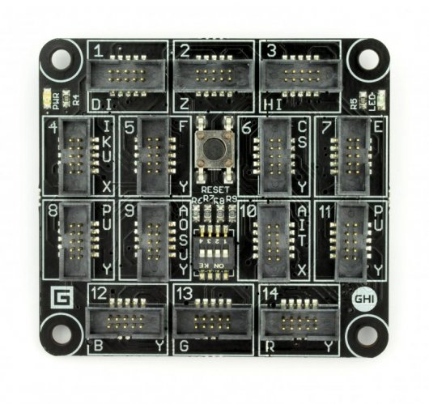
FEZ SPIDER MAIN BOARD

Slide 9
Sparkfun weather shield

Slide 10
Connect the dots azure icons
Event Hubs
Stream Analytics
Storage
(
Azure
Microsoft Azure
Web App
Service Bus
)
Storage blob
Storage table
SQL database
HDInsight
Machine
(
Learning
GitHub code
Git repository
generic
)

Slide 11
LEDs

Slide 12
Resistors
220Ω
1st Digit
2nd Digit
Multiplier
Tolerance
Color | Name | 1st Digit | 2nd Digit | Multiplier | Tolerance
 | Black | 0 | 0 | X1
 | Brown | 1 | 1 | X10 | 1%
 | Red | 2 | 2 | X100
 | Orange | 3 | 3 | X1,000
 | Yellow | 4 | 4 | X10,000
 | Green | 5 | 5 | X100,000
 | Blue | 6 | 6 | X1,000,000
 | Violet | 7 | 7
 | Grey | 8 | 8
 | White | 9 | 9
 | Gold |  |  | X0.1 | 5%
 | Silver |  |  | X0.01 | 10%
330Ω
10KΩ

Slide 13
cables

Slide 16
Micro SD Cards
Font: Segoe UI Semibold

